Slide 1

Presentation Materials Created by Mimetics Inc.
Free use by anyone for non-commercial purposes
Copyrights, Trademarks and other Registered Marks the Property of their Owners

Slide 2
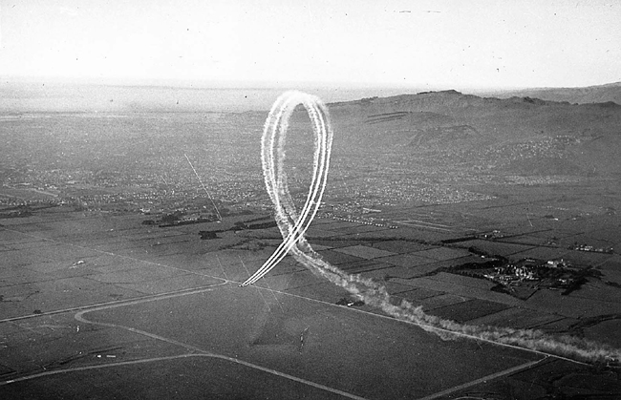
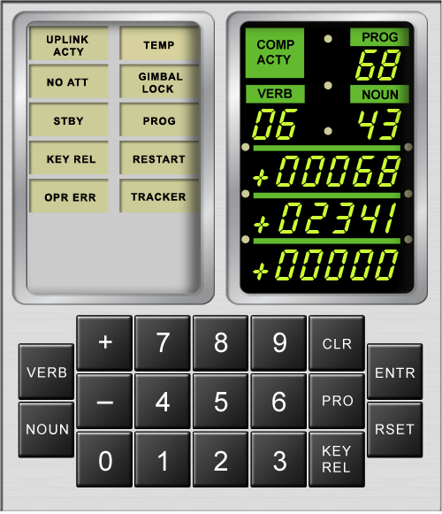
Grade 8 Systems - Lesson 2
Programming the Jade Robot
Notes:
We want to introduce the Jade Robot and it’s Tools in more detail along with our action plans for it.
It’s interesting, but it’s easy to criticize something when it’s done (especially when you have experience) – a *LOT* more difficult getting it right from the start. Also, preparing this presentation was a great way to review and think about what we should be doing.

Slide 3
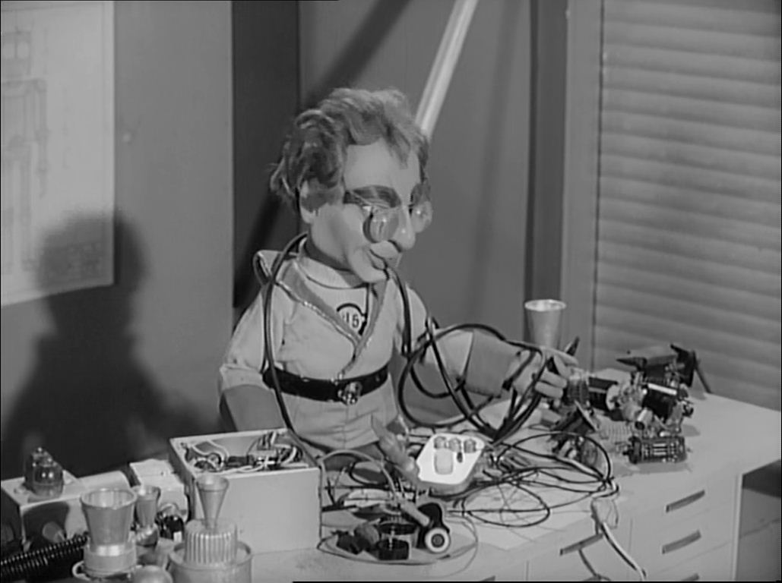
Rule One
Robots Run on the Floor
NO BROKEN ROBOTS!
Notes:
Can Demo Jade Scratch if people are interested. In doing this product I’ve had a few interesting discoveries – one was going with a simpler programming language actually has a *LOT* of value for an expert like myself.

Slide 4

Rule Two
We ALL Stay Together
Don’t Go Ahead Until Told
If You Have a Problem, Put Up Your Hand!
Notes:
Can Demo Jade Scratch if people are interested. In doing this product I’ve had a few interesting discoveries – one was going with a simpler programming language actually has a *LOT* of value for an expert like myself.

Slide 5

Recap
What is Programming?
How many milli-seconds are in 1 second?
What are the parts of the “Jade Support” Development Tool
Notes:
Can Demo Jade Scratch if people are interested. In doing this product I’ve had a few interesting discoveries – one was going with a simpler programming language actually has a *LOT* of value for an expert like myself.

Slide 6
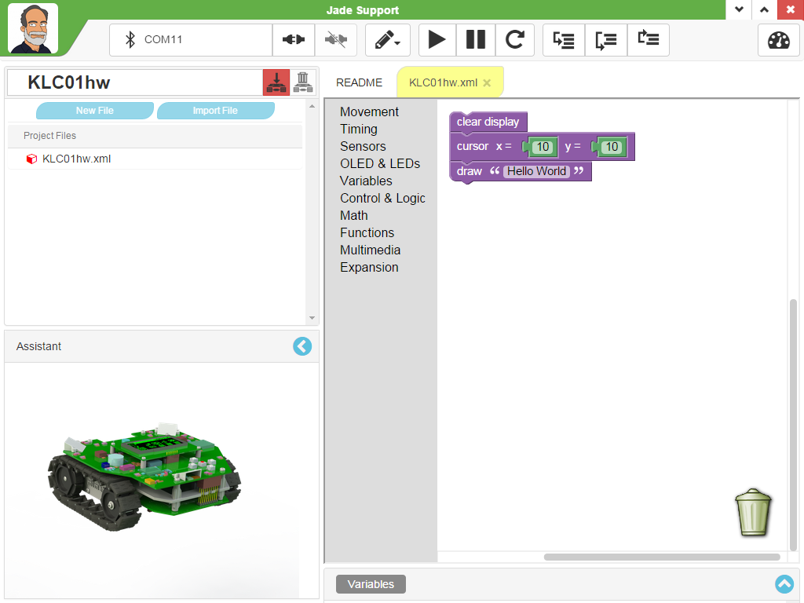
Jade Support
What do these buttons do?
What does this do?
What goes here?
What is this called?
What is this called?
Notes:
Can Demo Jade Scratch if people are interested. In doing this product I’ve had a few interesting discoveries – one was going with a simpler programming language actually has a *LOT* of value for an expert like myself.

Slide 7
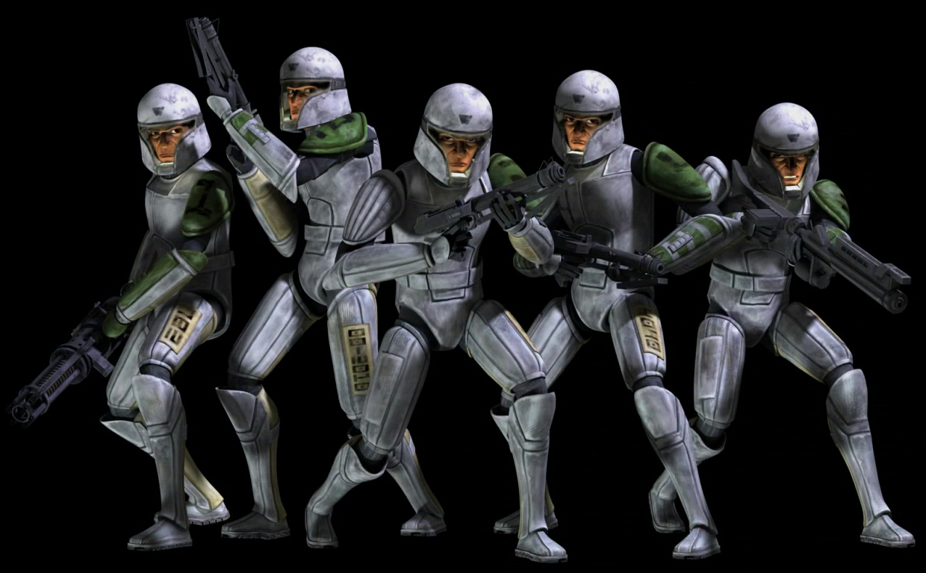
Cloning a Project
Notes:
We clone a community project into “My Projects” so we can make changes to it without affecting all the “Community Projects”

Slide 8
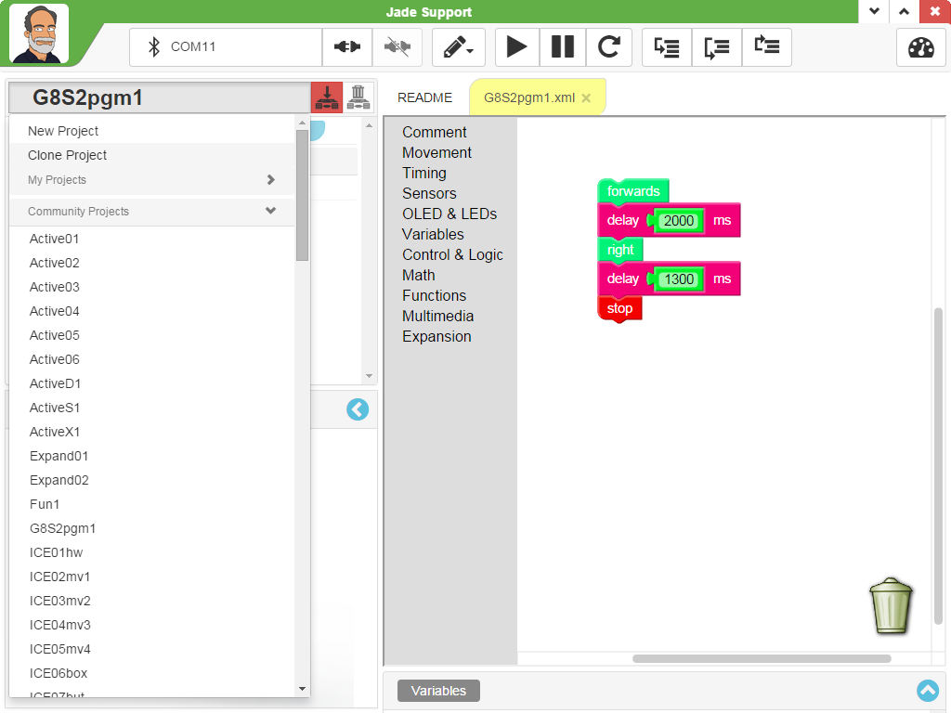
Cloning a Project
Step 1. Load in “G8S2pgm1” from “Community Projects”
Step 2. In Project Pull Down, Click “Clone Project”
Notes:
Can Demo Jade Scratch if people are interested. In doing this product I’ve had a few interesting discoveries – one was going with a simpler programming language actually has a *LOT* of value for an expert like myself.

Slide 9
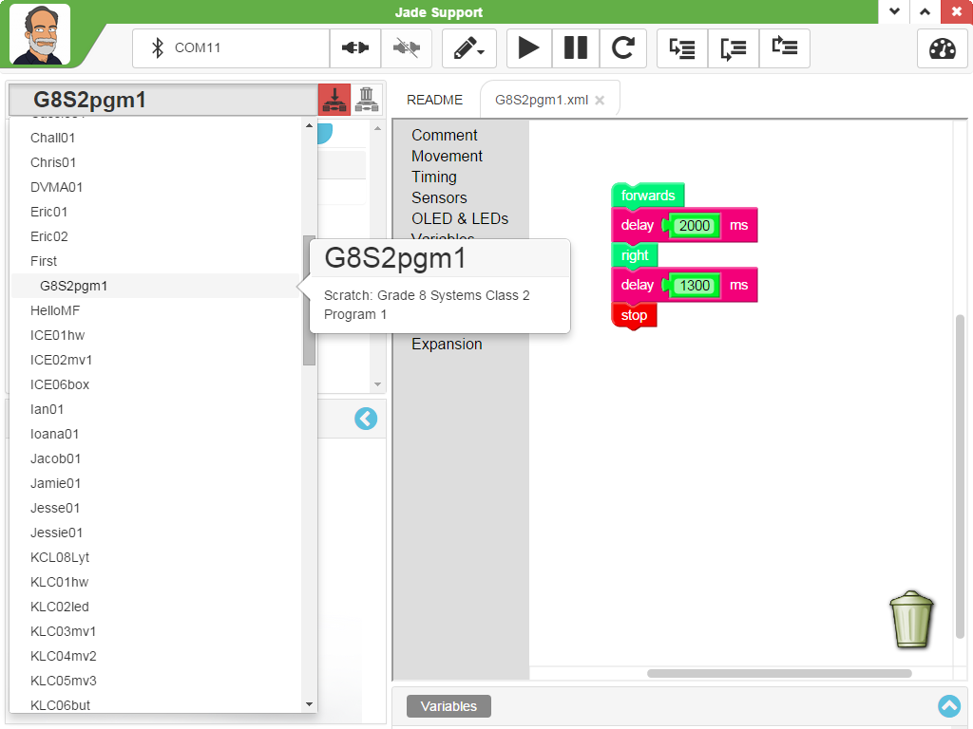
Cloning a Project
Project Tab is White for “My Projects”
Step 3. Load in “G8S2pgm1” from “My Projects”
Notes:
Can Demo Jade Scratch if people are interested. In doing this product I’ve had a few interesting discoveries – one was going with a simpler programming language actually has a *LOT* of value for an expert like myself.

Slide 10
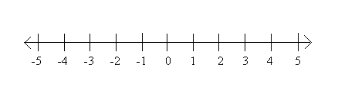
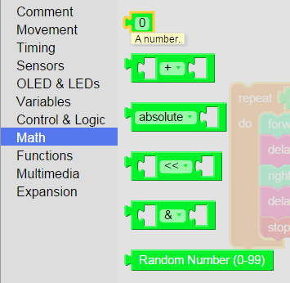
Constants
To +2.15Billion
To -2.15Billion
When a Constant Number is Required, Goto
Math ➔ Constant
Counting from 0 to 2.15Billion one digit per second will
Take 68 years
Notes:
Can Demo Jade Scratch if people are interested. In doing this product I’ve had a few interesting discoveries – one was going with a simpler programming language actually has a *LOT* of value for an expert like myself.

Slide 11
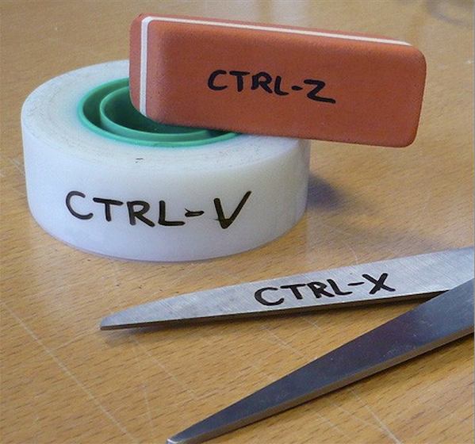
Tools for Editing a Project
Notes:
Can Demo Jade Scratch if people are interested. In doing this product I’ve had a few interesting discoveries – one was going with a simpler programming language actually has a *LOT* of value for an expert like myself.

Slide 12
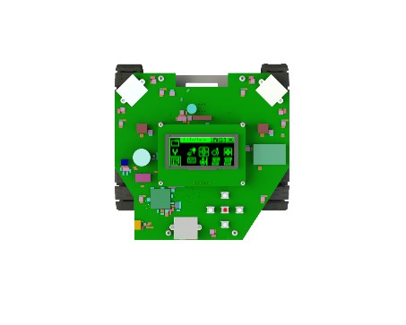
Repeating Code Operation
G8S2pgm1 Moves Forwards &
Turns Right
How do we make Robot Move in a
Square?
Notes:
Can Demo Jade Scratch if people are interested. In doing this product I’ve had a few interesting discoveries – one was going with a simpler programming language actually has a *LOT* of value for an expert like myself.

Slide 13
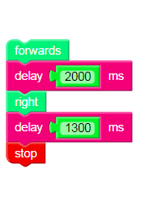
Looping
“Loops” are blocks which cause the Instructions Inside them to Repeat
Notes:
Can Demo Jade Scratch if people are interested. In doing this product I’ve had a few interesting discoveries – one was going with a simpler programming language actually has a *LOT* of value for an expert like myself.

Slide 14
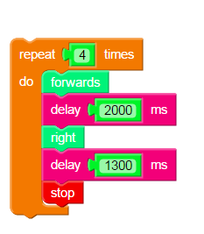
Repeat # Loop
“Repeat” is Found in “Control & Logic” Toolbox
“Repeat” block wraps around code to Loop
Modify G8S2pgm1 with the Repeat Block and execute repeating code
Notes:
Can Demo Jade Scratch if people are interested. In doing this product I’ve had a few interesting discoveries – one was going with a simpler programming language actually has a *LOT* of value for an expert like myself.

Slide 15
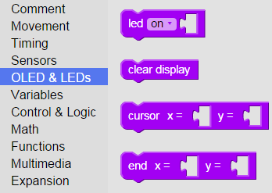
Jade Robot LEDs
To Control the LEDs, use the “LED” Tool in the “OLED & LEDs” Toolbox
LED5
LED0
LED4
LED1
LEDs can be “on”, “off” or “flash”
LED3
LED2
Notes:
Can Demo Jade Scratch if people are interested. In doing this product I’ve had a few interesting discoveries – one was going with a simpler programming language actually has a *LOT* of value for an expert like myself.

Slide 16
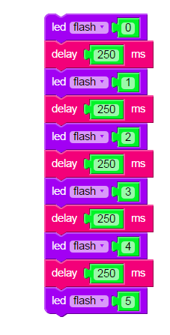
Try G8S2pgm2
Clone G8S2pgm2 and add:
Repeat Loop
Movement and use LEDs as Turn Indicators
Notes:
Can Demo Jade Scratch if people are interested. In doing this product I’ve had a few interesting discoveries – one was going with a simpler programming language actually has a *LOT* of value for an expert like myself.

Slide 17
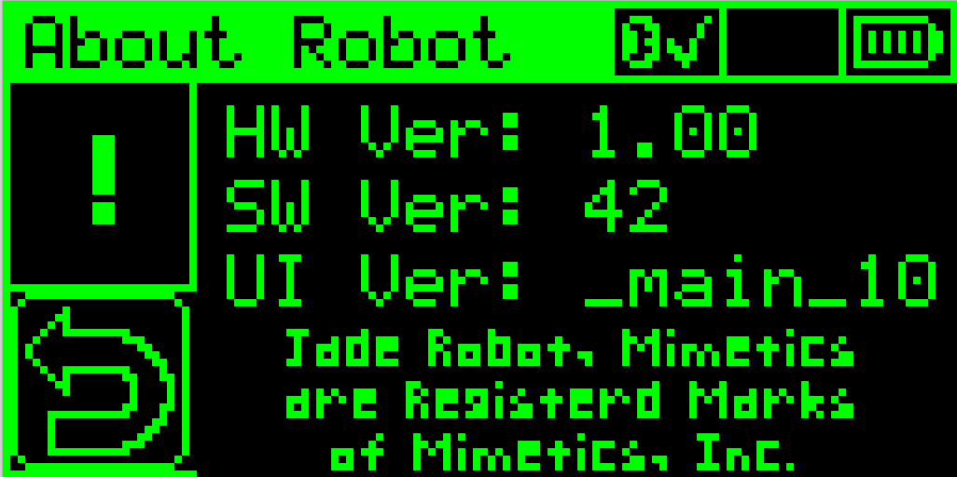
OLED Display
Origin (0,0)
End (127, 63)
Notes:
Can Demo Jade Scratch if people are interested. In doing this product I’ve had a few interesting discoveries – one was going with a simpler programming language actually has a *LOT* of value for an expert like myself.

Slide 18
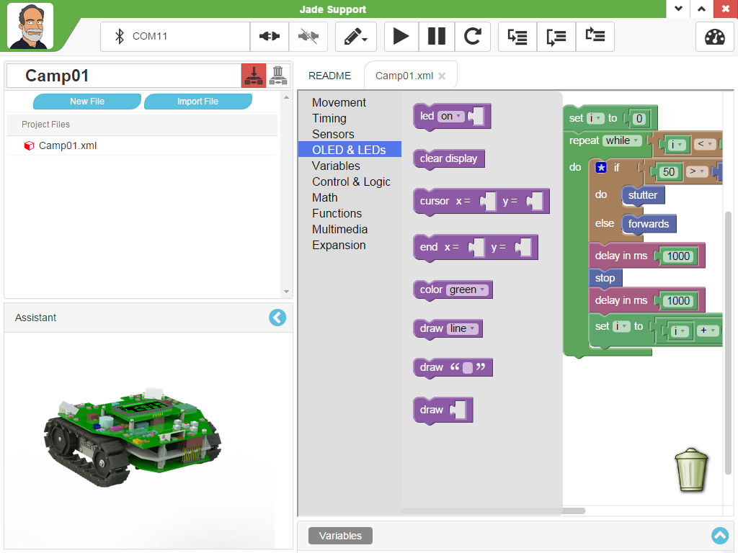
LED & OLED Status Updates Blocks
LED On/Off/Flash – LEDs 0 - 5
Clear OLED Display
Set Position of Next “draw”
“draw” Text String, Cursor Updated
“draw” Integer, Cursor Updated
Notes:
Can Demo Jade Scratch if people are interested. In doing this product I’ve had a few interesting discoveries – one was going with a simpler programming language actually has a *LOT* of value for an expert like myself.

Slide 19
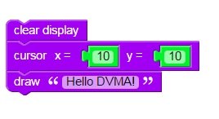
Try G8S2pgm3
Clone G8S2pgm3 and:
Change the Message
Change the Message Position
Add Additional Messages
Notes:
Can Demo Jade Scratch if people are interested. In doing this product I’ve had a few interesting discoveries – one was going with a simpler programming language actually has a *LOT* of value for an expert like myself.

Slide 20
Stop Here
Notes:
Can Demo Jade Scratch if people are interested. In doing this product I’ve had a few interesting discoveries – one was going with a simpler programming language actually has a *LOT* of value for an expert like myself.

